Slide 1
Cloud Computing
Sameer Mahajan
https://www.linkedin.com/in/sameersmahajan/

Slide 2
The Vision
In 1969, Leonard Kleinrock, one of the chief scientists of the one of the chief scientists of the original Advanced Research Projects Agency Network (ARPANET) predicted Computer utilities like water, electricity
don’t care where my servers are, who manages them, where my documents are stored, or where my applications are hosted. I just want them always available and access them from any device connected through Internet. And I am willing to pay for this service for as much as I need it.
IT services are traded as utilities in an open market
No infrastructure needed on consumer side

Slide 3
Definition
Internet plays important role
Armbrust: Cloud computing refers to both the applications delivered as services over the Internet and the hardware and system software in the datacenters that provide those services.
Gartner: a style of computing in which massively scalable IT-enabled capabilities are delivered as a service to external customers using Internet technologies
U.S. National Institute of Standards and Technology (NIST): Cloud computing is a model for enabling ubiquitous, convenient, on-demand network access to a shared pool of configurable computing resources (e.g., networks, servers, storage, applications, and services) that can be rapidly provisioned and released with minimal management effort or service provider interaction.
Zero capital expenditure is necessary to get started.

Slide 4
Benefits
No up-front commitments
On-demand access
Nice pricing
Simplified application acceleration and scalability
Efficient resource allocation
Energy efficiency
Seamless creation and use of third-party services

Slide 5
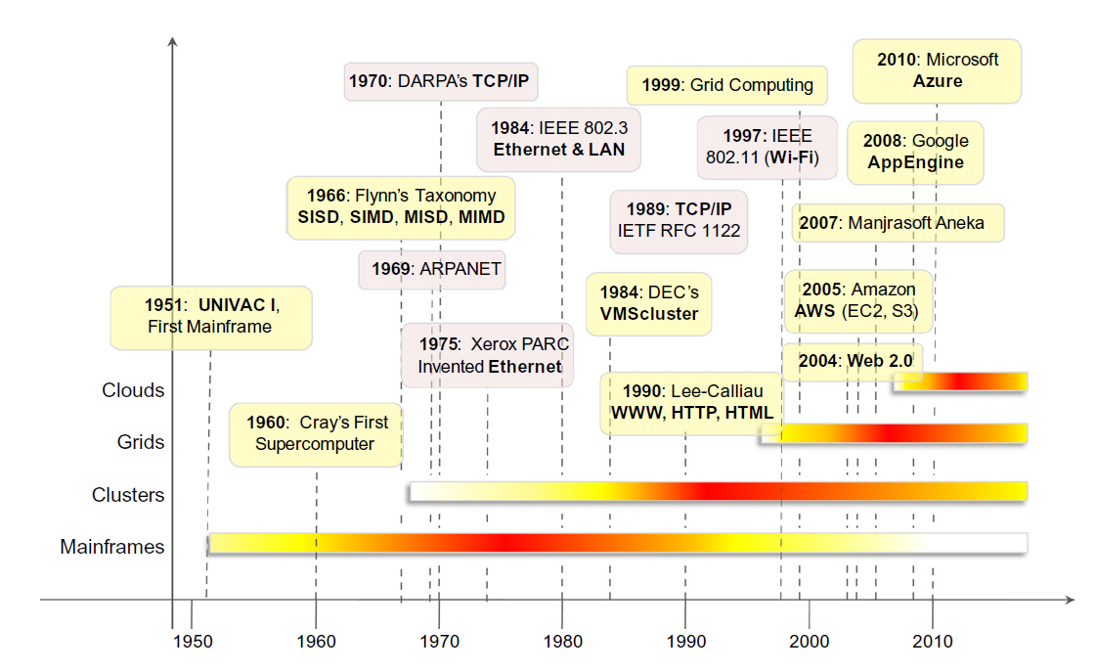
Evolution

Slide 6

Mainframe

Slide 7
Web 2.0
Web is the primary interface
Interactivity and flexibility into web pages
XML, AJAX, Web Services
Variety of devices: mobile phones, car dashboards, TV sets, IoT
Extremely dynamic applications, lightweight, loose coupling
Wide availability via media accessibility or affordability
Google maps, flickr, facebook, twitter, youtube

Slide 8
Evolution (contd)
Service oriented
Utility oriented
Grid computing
HPC
Parallel Programming
Distributed Computing

Slide 9
Challenges
How many and how long for maximizing benefit
Tradeoff between availability and price
Longevity – how long your provider will be in business?
Business Continuity: 9/11, multi region
SLA
Quality of Service (QoS): measure of user experience
Security
Regulatory, Legal

Slide 10
Summary
Vision
Definition
Benefits
Evolution
Challenges

Slide 11
Assignment
Signup for AWS
Create Ubuntu VM
Create private – public keypair
Connect to VM using putty and .ppk
Sudo apt install apache2
Edit /var/www/html/index
Edit inbound rules to allow port 80
Connect to <your VM’s public address> from browser
Complete video: https://youtu.be/RLeQ9lNROr0

Slide 12
Parallel and Distributed Computing
Sameer Mahajan
https://www.linkedin.com/in/sameersmahajan/

Slide 13
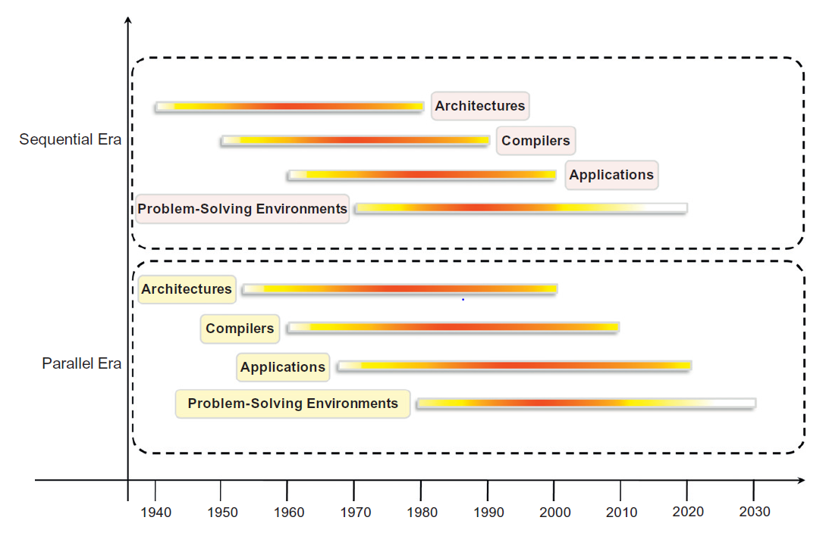
Computing Era

Slide 14
Factors for parallel and distributed computing
Ever increasing computation requirements
Saturation reached of sequential computation
Hardware improvements in pipelining are non scalable, required compiler technologies are difficult
Vector processing is useful only for scientific applications with matrices and not generic e.g. for databases
Improvements in networking
Parallel processing technology is mature, commercially viable, wide support with development tools and environments
Scaling: scale up, scale out

Slide 15
Parallel and Distributed Computing
Parallel
Computation is divided among several processors
Sharing the same memory
Homogeneity of components
Distributed shared memory connected by InfiniBand
Distributed
Computation broken down into units and executed concurrently
Wider range of systems and applications
Heterogeneous

Slide 16
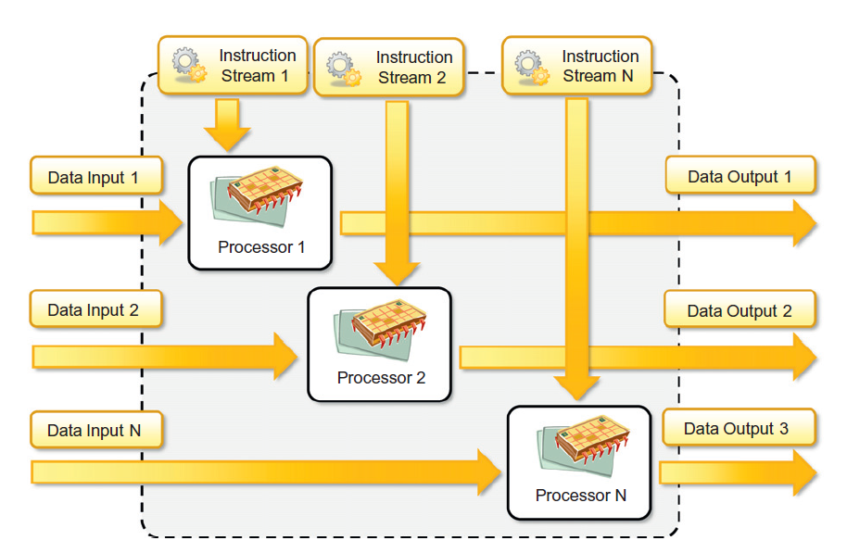
Hardware architectures for parallel processing
SISD
SIMD
MISD
MIMD
Data / Process
Parallelism

Slide 17
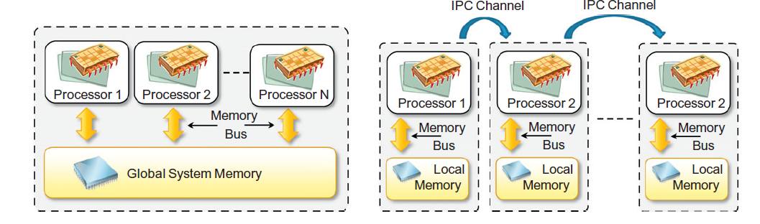
Shared and Distributed Memory MIMD

Slide 18
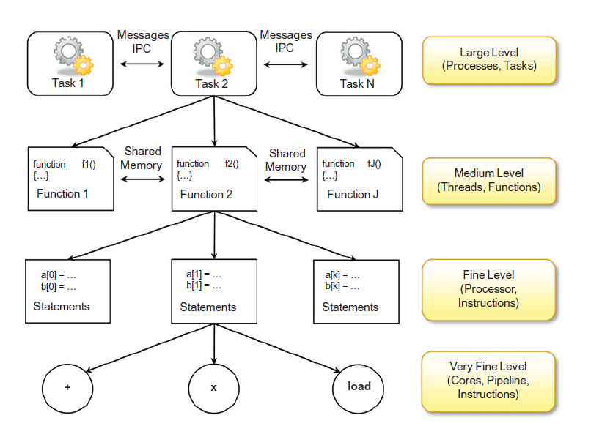
Levels of Parallelism

Slide 19
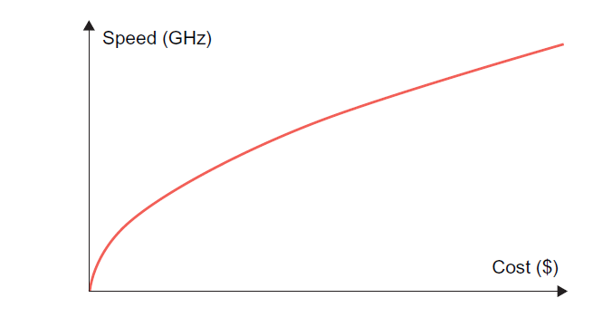
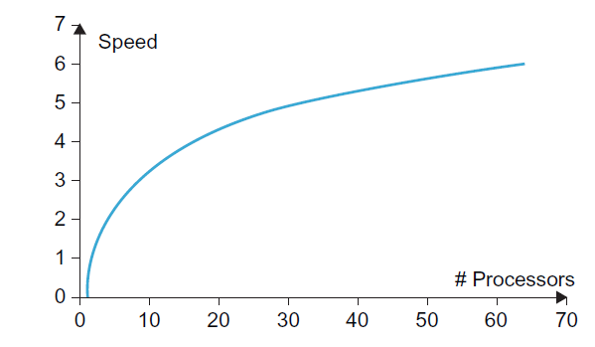
Speed up grapahs
Square root
Logarithmic

Slide 20
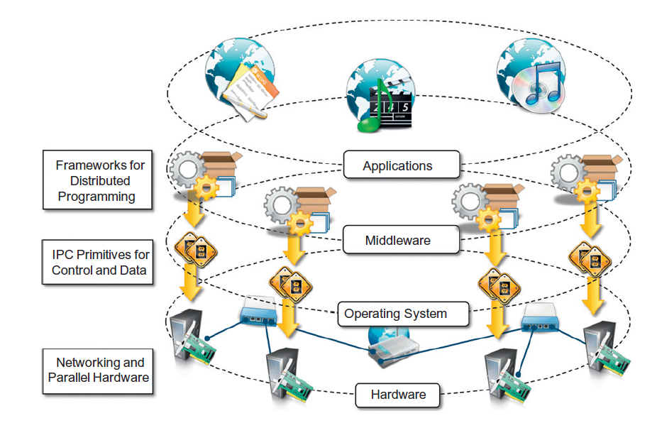
Distributed Computing:
Collection of
independent computers
that appears to its users
as a single coherent
system

Slide 21
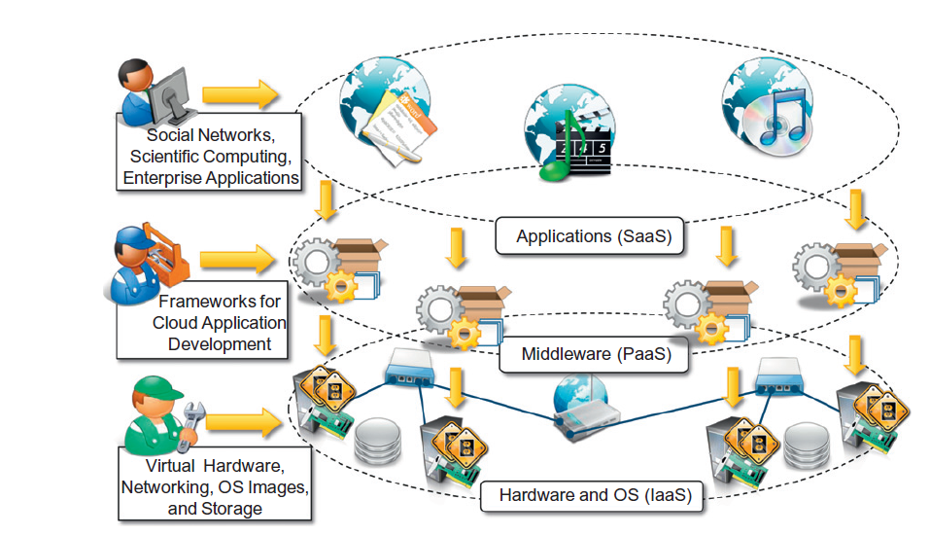

Slide 22
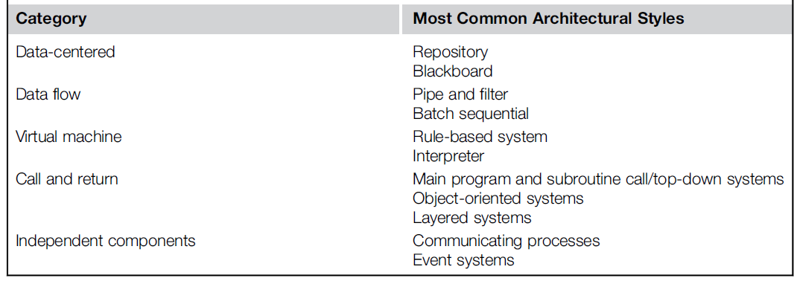
Software Architectural Styles

Slide 23
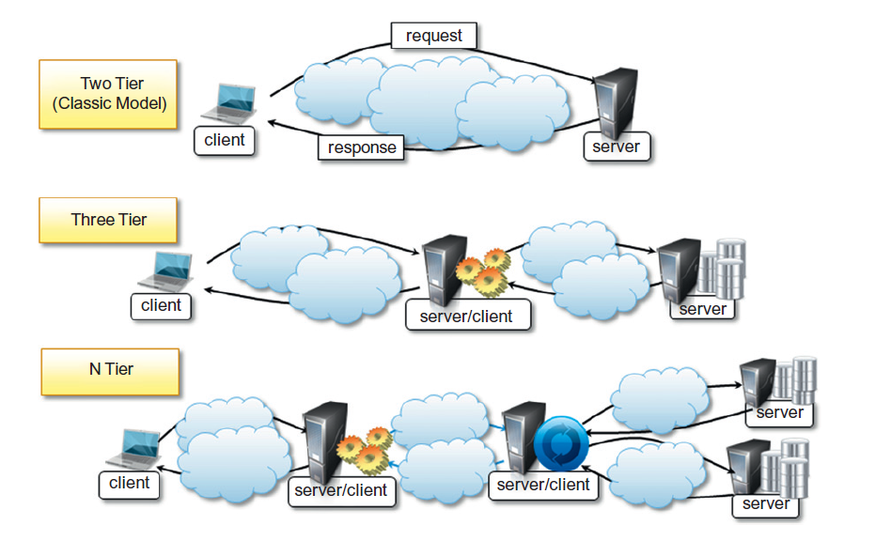
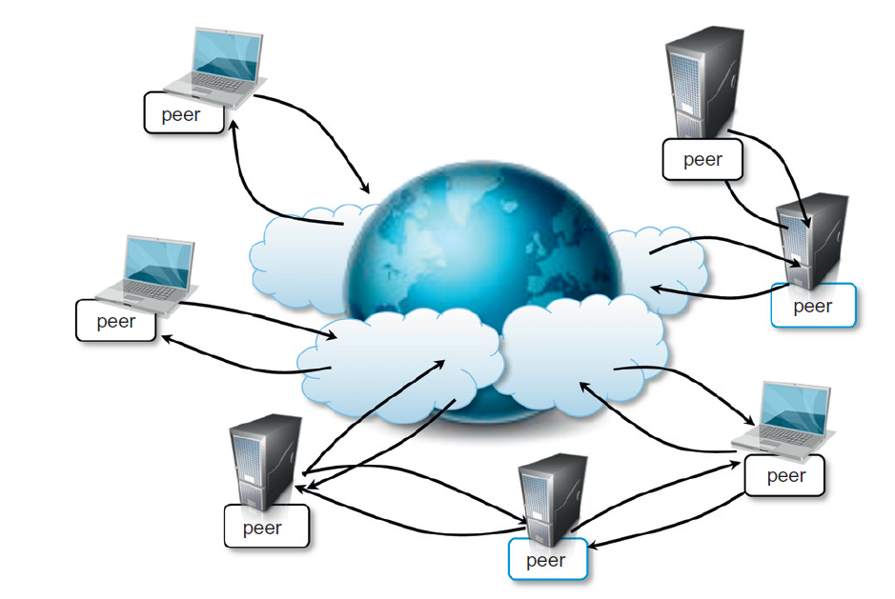
System Architectural Styles
Client - Server
Peer to Peer

Slide 24
Inter Process Communication (IPC)
Message: discrete amount of information that is passed from one entity to another
Message passing: MPI, OpenMP
Remote Procedure call (RPC): marshaling parameters and return values
Distributed objects: state management and lifetime – CORBA, COM, .Net Remoting
Distributed agents and active objects: objects with control thread
Web Services: RPC over HTTP, Simple Object Access Protocol (SOAP) or Representational State Transfer (REST) protocols

Slide 25
Messaging Models
Point to point: direct addressing to identify the message receiver, no central infrastructure, initiated by sender
Direct
Queue based
Publish and subscribe: topic or event, one to many, kafka
Push: publisher notifies all interested subscribers
Pull: subscriber poll for the messages of their interest
Request-reply: each request has a reply, mostly point to point and not publish subscribe

Slide 26
Technologies
RPC: gRPC
Server procedures
Register remote procedures with RPC Server
Client invoking remote procedures
Distributed Object Frameworks: proxy skeleton
Objects distributed across heterogeneous network acting coherently
Server registry of active objects is published
Client accesses these objects using interfaces and invokes methods

Slide 27
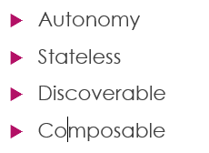
Service Oriented Architecture (SOA)
Service is a unit of functionality (Don Box)
Explicit boundaries
Autonomous
Expressed as schema and contracts, not class or interface definitions
Sematic compatibility is determined based on policy
Guiding Principles
Standardized service contracts
Loose coupling
Abstraction
Reusability

Slide 28
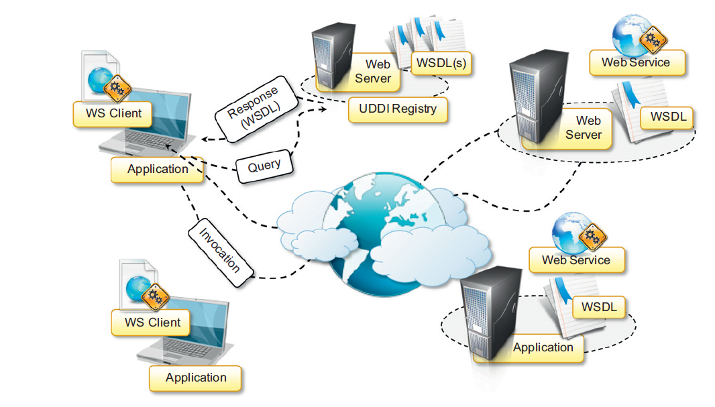
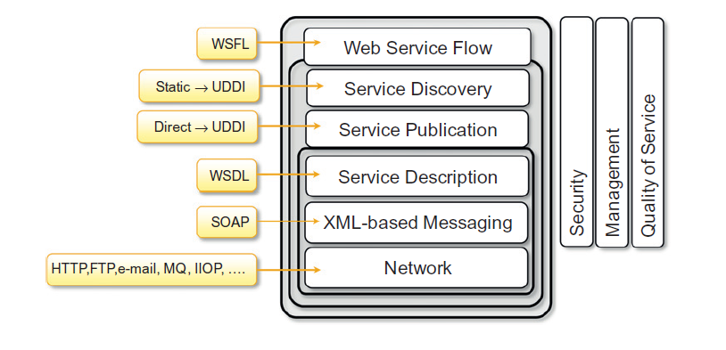
Web Services

Slide 29
Abstraction and Virtualization
Sameer Mahajan
https://www.linkedin.com/in/sameersmahajan/

Slide 30
Abstraction
Connecting multiple systems together leveraging their interfaces, not worrying about internal details
Uber / Ola as an example for transportation service
OSI – 7 layers of networking
ODBC – abstracting databases
OpenGL – images
Internet is an abstraction layer to cloud computing
Translation from abstraction layer to underlying physical layer

Slide 31
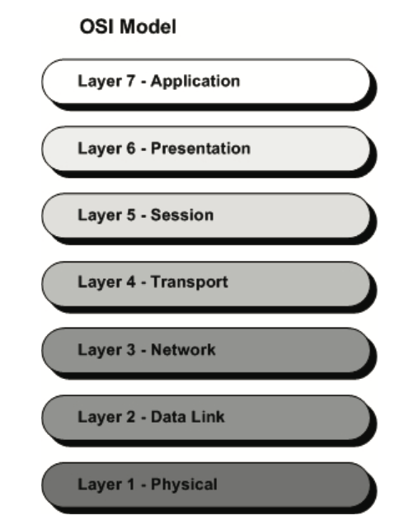
Open Systems
Interconnection
Vendor
Interconnection
Layer
Interconnection
Independent development at each layer

Slide 32
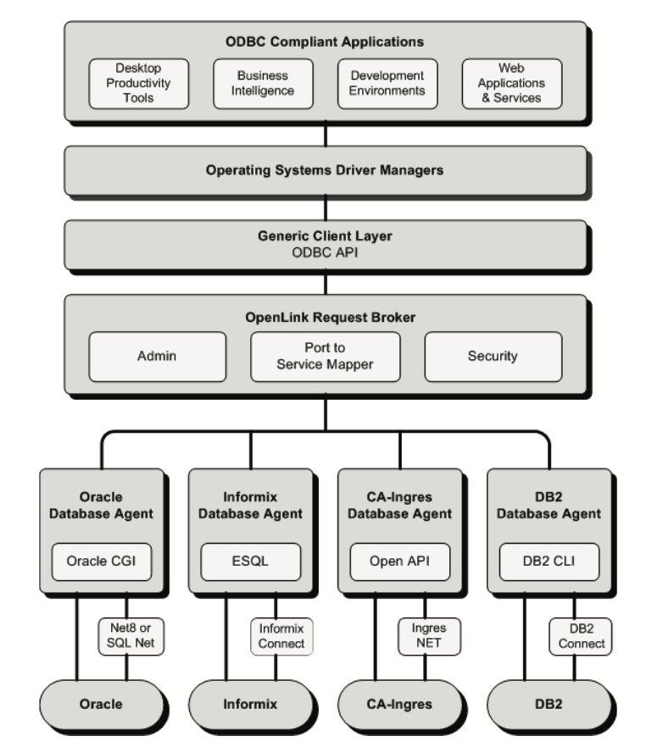
Open DataBase
Connection
Config change
ODBC driver

Slide 33
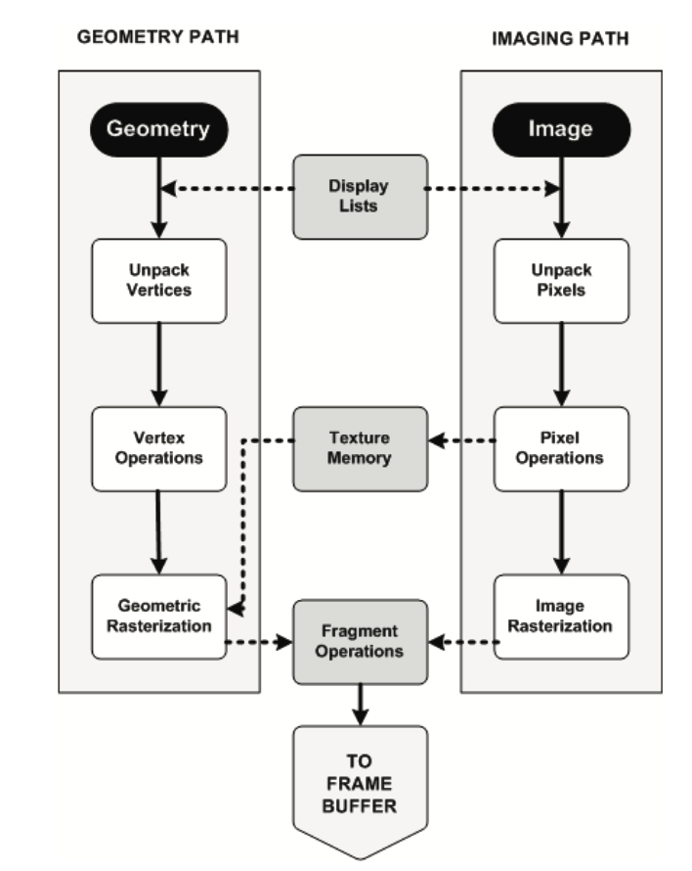
Open
Graphics
Library
Application development
and
Display adapter

Slide 34
Virtualization
Abstraction of hardware, runtime environments, storage and networking
Began in 1960s but widely adopted since 2000s
Physical Host – virtual guest, 1 physical server hosting tens of virtual guests
Virtual machine (VM) instances operate in complete isolation of each other
Customized software stack on demand in each VM instance

Slide 35
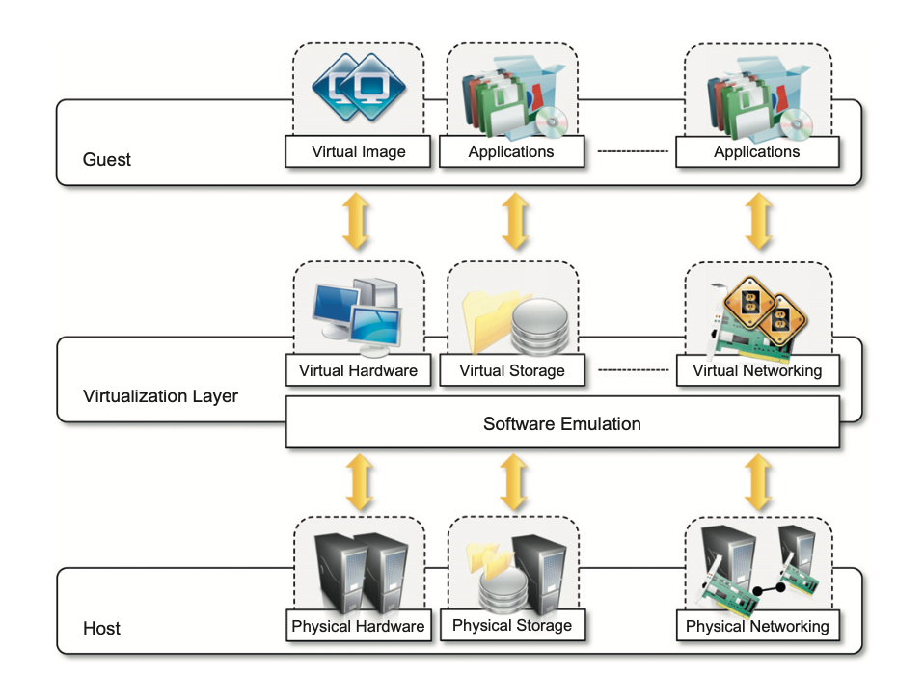

Slide 36
Factors
Increased computing capacity: server can host tens of VMs
Underutilized resources: using office desktops during night without affecting day work
Lack of space – server consolidation
Energy efficiency / Green initiatives
Increased administrative costs
1995 – Sun Java, 2002 - .Net

Slide 37
Characteristics
hardware virtualization
physical machine is the host
virtualization layer / virtual machine manager / hypervisor – software
virtual machines / guests interact with virtualization layer

Slide 38
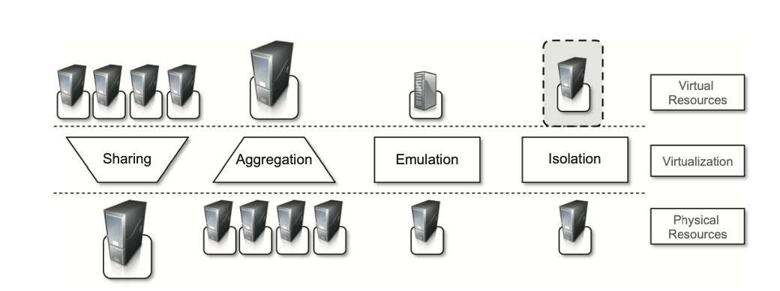
Advantages
Increased security – translation, control and filter guest activity, hide things on host from guest(s), limited access, separate FS
Managed execution

Slide 39
Advantages (contd)
Performance tuning
VM snapshot, migration
Portability : JVM jar, .Net assembly, VMWare VMDK – images; don’t need all applications and services but just VM manager

Slide 40
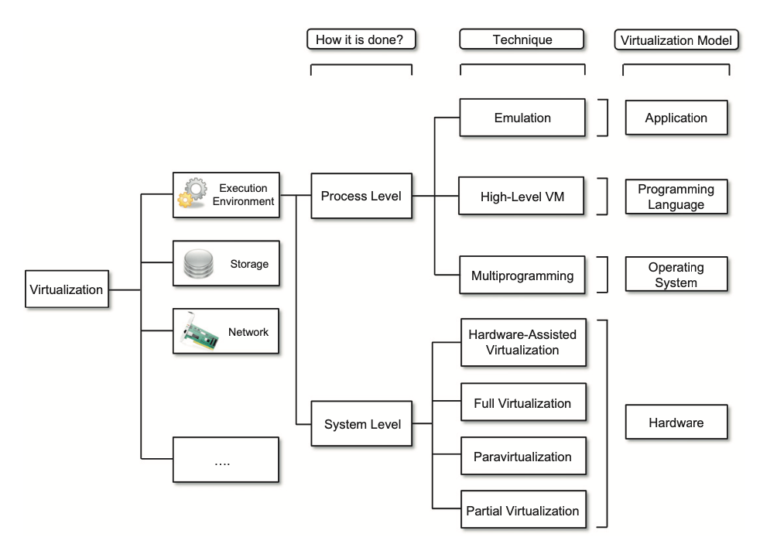

Slide 41
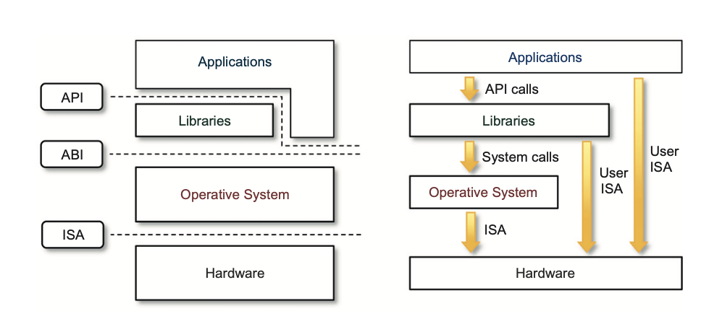

Slide 42
Levels of virtualization
Hardware level
Operating system level
Programming language level
Application level
Storage
Network
Desktop
Application server

Slide 43
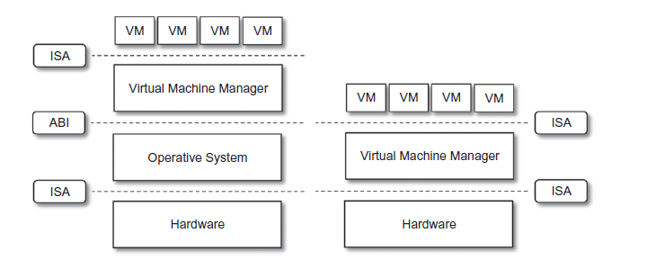
Hardware level virtualization
Hypervisor
Type I : on bare hardware, like OS, interact directly with ISA, native
Type II : require support of OS, interact with ABI, hosted

Slide 44
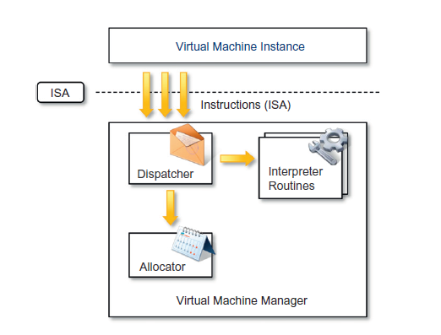
Hypervisor
Reference
Architecture

Slide 45
Virtual Machine Manager Criteria
Equivalence: should be same as that of phyisical host
Resource control: should be complete control of virtualized resource
Efficiency. A statistically dominant fraction of the machine instructions should be executed without intervention from the VMM.
Classification of instructions set
Sensitive instructions are subset of privileged instructions
Recursive virtualization: A VMM without any timing dependencies can be constructed for it
In hybrid VMM user sensitive instructions are subset of privileged instructions

Slide 46
Hardware Virtualization Techniques
Hardware assisted : architectural support, Intel x86-64 VT-x, AMD V (2006), less overhead
Full virtualization: running complete OS in VM like physical machine
Paravirtualization: thin virtualization layer, guest needs to be modified to use VMM interface, need OS source, Linux on Xen
Partial virtualization: partial execution of guest, Address space virtualization

Slide 47
Levels of Virtualization
OS Level: no VMM, within OS, evolution of Unix chroot, less overhead, solaris zones, containers (namespace)
PL level: JVM, .Net assembly
Application level: not installed on runtime hardware but run as if they were
Interpretation: every instruction is emulated, low startup but high overhead
Binary translation: block converted to native instructions, cached and reused
Wine: Unix like on Windows
WABI: Win16 on Solaris
CrossOver: Windows on Mac OS X
VMWare ThinApp

Slide 48
Other than execution virtualization
Storage Virtualization: decouple physical from logical, Storage Area Networks (SAN), NAS, enabled SDS
Network Virtualization: VLAN, Network Address Translation (NAT) enabled SDN
Desktop Virtualization: making the same desktop environment accessible from everywhere, VDI
Application server virtualization: achieved using load balancers

Slide 49
Enablers for Cloud Computing
Hardware level – IaaS
PL level – PaaS
Migrate VMs to free up servers, server consolidation
Storage services
Network services
VDI: your entire desktop can come from cloud

Slide 50
Advantages & Disadvantages
Sandbox, Prevent any harmful operation cross the boundary
Portable across physical systems, self contained without any dependencies, represented by one or two files
Low maintenance
Performance degradation
Inefficiency and degraded user experience: inaccessible features
Security holes, threats, phishing: extract sensitive information from guest, BluePil, SubVirt

Slide 51
VMWare: full virtualization
Hardware replicated, guest not modified and not aware of abstraction layer in between, desktop type II, server type I, direct execution for non sensitive instructions, binary translation for sensitive instructions, ecosystem
X86 architecture does not meet theorem I, dynamic binary translation, trap is generated for privileged instructions and translation performed, caching of translation to improve performance
CPU, memory and I/O devices (keyboard, mouse, USB, network controllers) virtualization
Translation Look-aside Buffer (TLB) to improve MMU performance

Slide 52
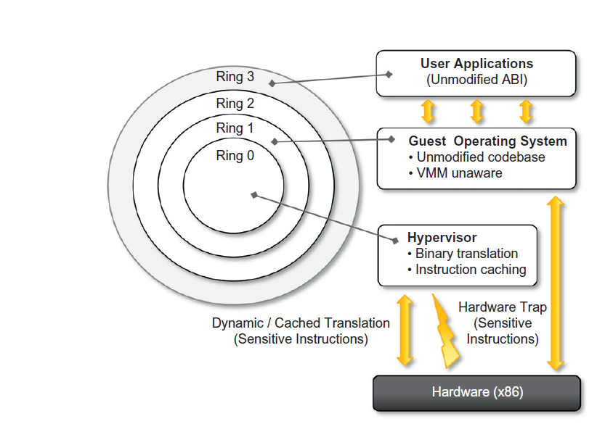

Slide 53
Xen: paravirtualization
Research by Cambridge University, UK
Open source community
Citix offers commercial offering of XenSource
Desktop or server virtualization
Xen Cloud Platform XCP
Full virtualization with hardware assistance
Xen Hypervisor, domains, hypercalls

Slide 54
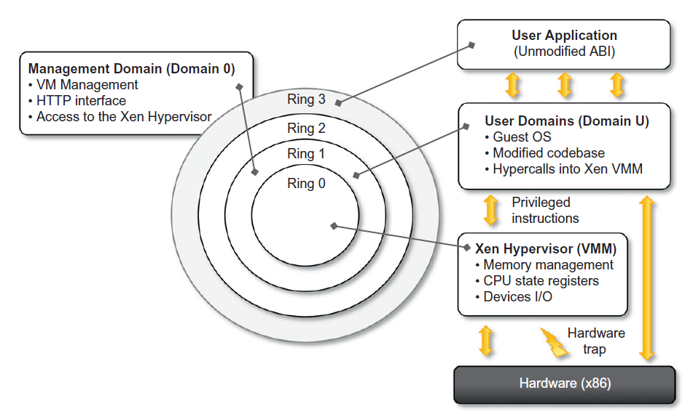

Slide 55
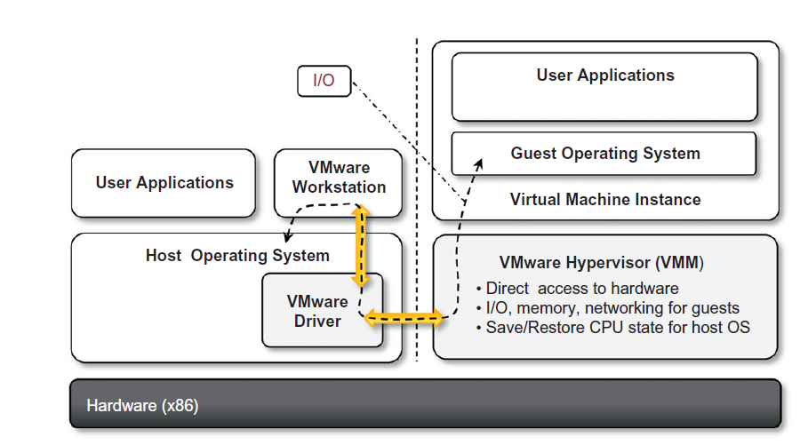
End user
VMWare
Workstation
Architecture

Slide 56
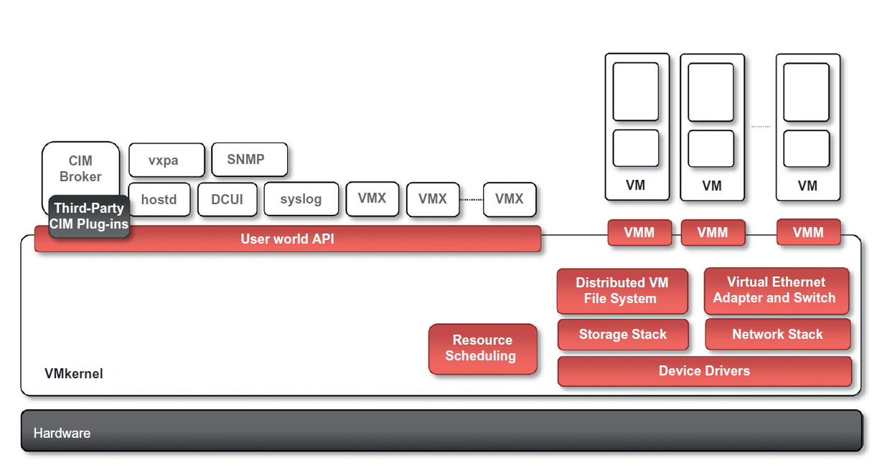

Slide 57
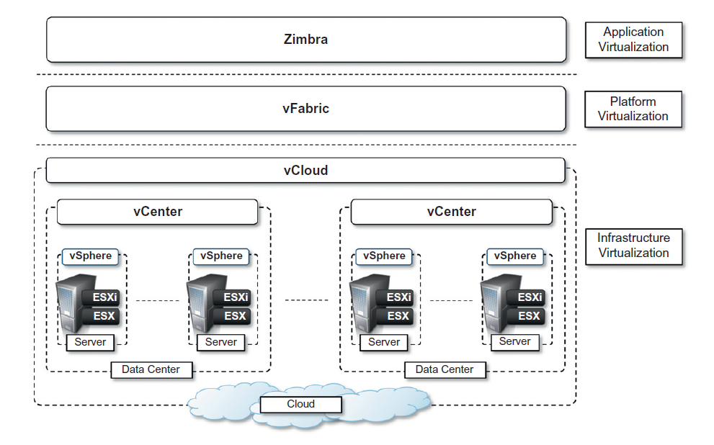

Slide 58
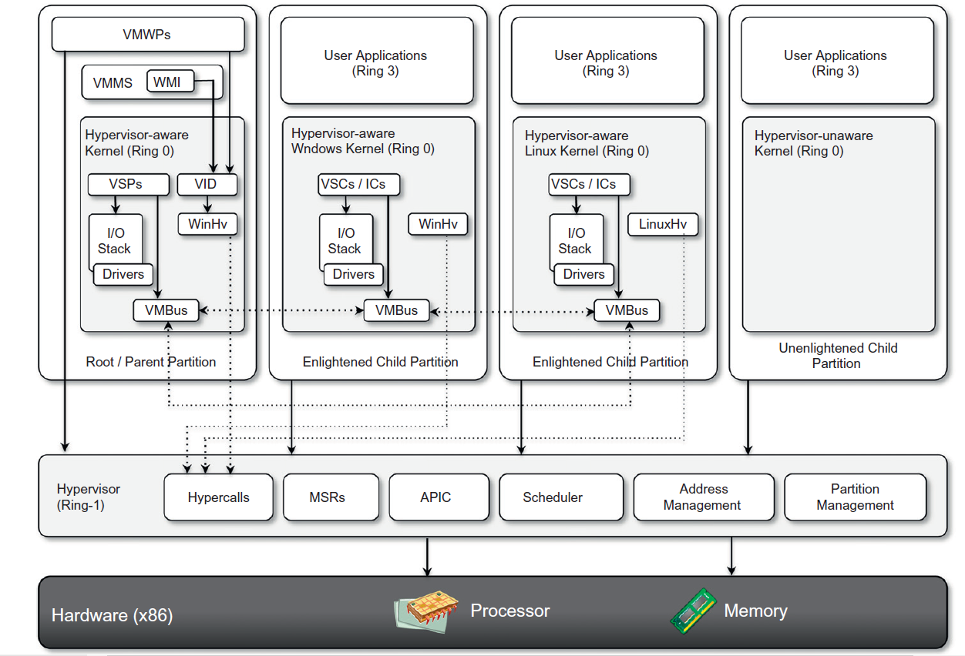

Slide 59
Releases
Hyper-Viscurrently shipped as a component of Windows Server 2008 R2 that installs the hypervisor as a role within the server
Windows Server Core to increase performance with smaller footprint, reduced maintenance, reduced management, use of “removed” rich features by remote management through WMI (e.g. powershell)
SystemCenter Virtual MachineManager(SCVMM)2008
Management portal
V2V, P2V conversions
Deep powershell integration

Slide 60
Assignment
Install VMWare ESXi server
Create Ubuntu VM
Connect to Ubuntu VM

Slide 61
Cloud Computing Architecture
Sameer Mahajan
https://www.linkedin.com/in/sameersmahajan/

Slide 62
Cloud Computing Architecture
Distributed infrastructure
Data center(s), cluster(s), composed of desktops, workstations, servers
Infrastructure can be owned by provider or rented from third party
Typically virtualized for workload isolation and cost optimization
Different layers stacked on each other
Utility oriented, internet centric, IT services on demand, covering the entire computing stack from hardware infrastructure to development platforms and distributed applications

Slide 63
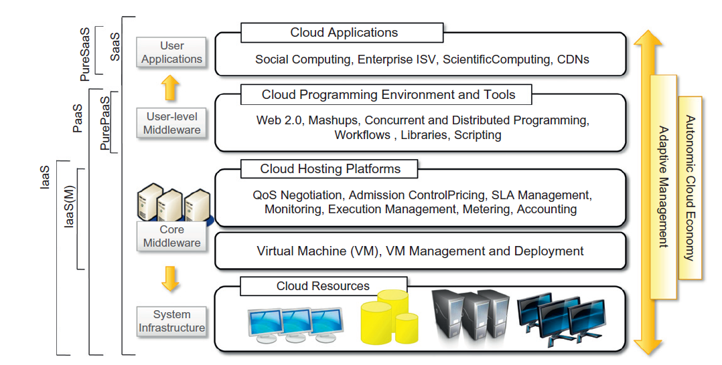
Reference Model

Slide 64
IaaS
Infrastructure or hardware as a service
Most popular and developed market segment of cloud computing
from single servers to entire infra- structures, including network devices, load balancers, and database and Web servers
Main technology used: hardware virtualization
Atomic component of VM priced by memory, #processors, and disk size
workload partitioning, application isolation, sandboxing, and hardware tuning
LAMP: Linux Apache MySql and PHP

Slide 65
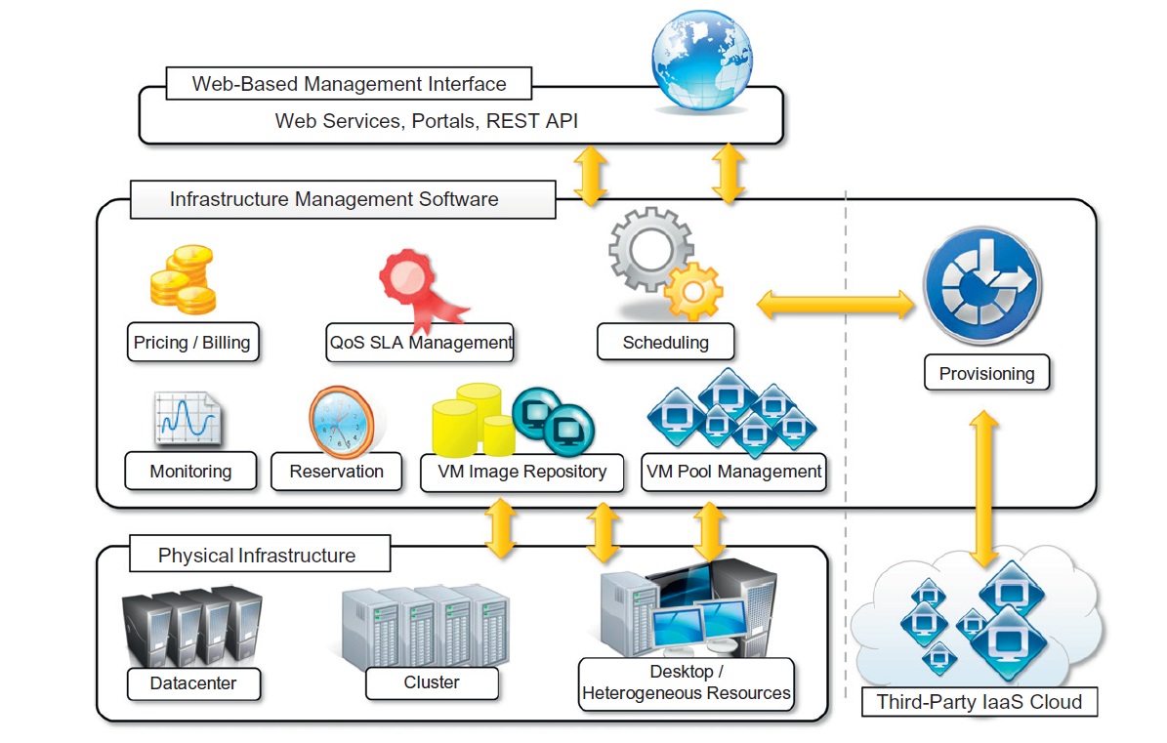

Slide 66
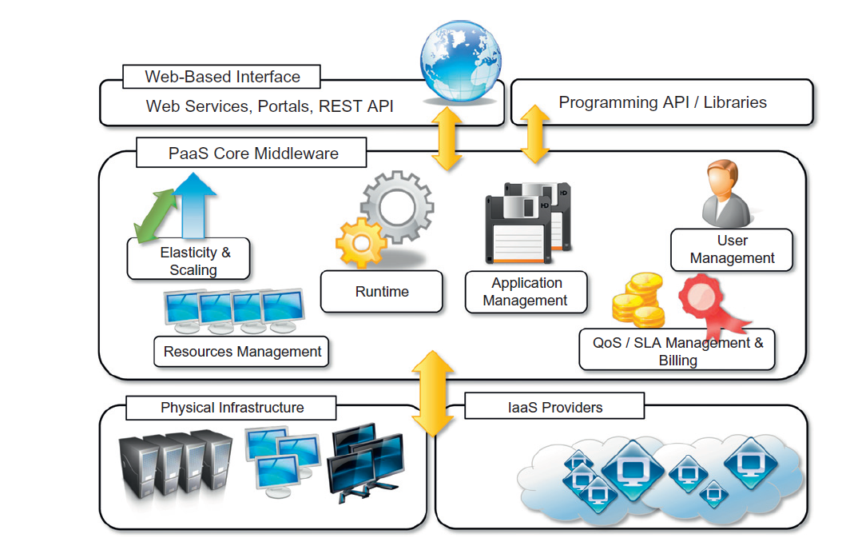

Slide 67
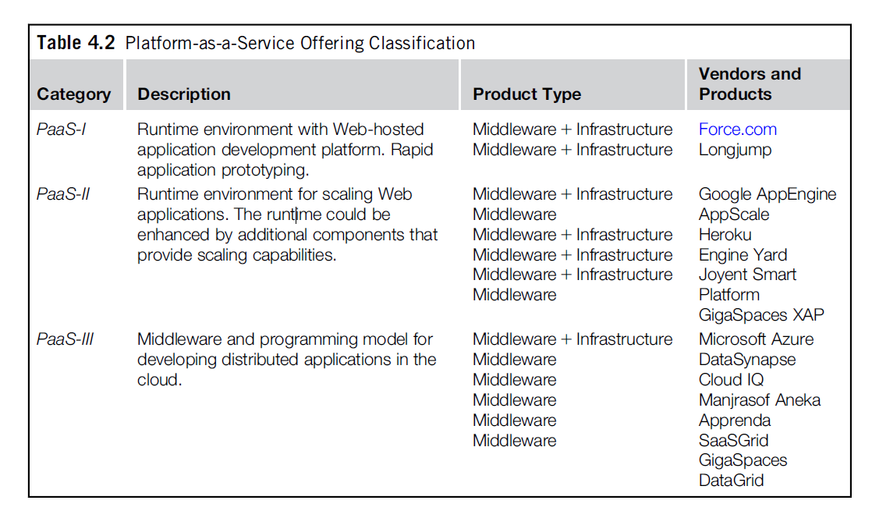

Slide 68
Essential Characteristics of PaaS
Runtime framework
Higher level of abstraction
Automating deployment and scaling
Cloud Services and APIs to simplify the creation and delivery of elastic and highly available cloud applications
Integration of third party cloud services leveraging SOA
Vendor lockin
Optimize development, deployment and management of applicaitons

Slide 69
SaaS
Complete applications as a service
No hardware, software cost, pay as you go subscriptions
One-to-many, hosted, some customization
Multitenant
SaaS coined in 2001, predates cloud computing, Application Service Providers (ASP)
SaaS 2.0 rapid achievement of business objectives, integration, interconnected
Salesforce (CRM), Facebook (social networking), linkedin,Google Documents

Slide 70
Types
Clouds are a type of parallel and distributed system harnessing physical and virtual computers presented as a unified computing resource
Public: open to the wider public
Private: limited to an institution, intranet
Hybrid or heterogeneous: combination of the above two
Community: for a specific industry
Multi: combination of on-premises, private, public, and edge

Slide 71
Public Cloud
First expression of cloud computing
Anyone, anywhere, any time via Internet
Useful to start small enterprises without incurring any capex
Grow or shrink according to business needs, sustain peak load
Renting infrastructure or subscribing to services
Replace or extend
Multitenancy, QoS
Monitoring: uptime, usage (for billing), activity
AWS EC2: IaaS, Google AppEngine: PaaS, salesforce.com: SaaS

Slide 72
Private Cloud
Control, privacy, government, military agencies
Depending on where data resides: US APATRIOT Act provides its government and other agencies access to information, including that belonging to any company that stores information in the U.S. territory
Can leverage existing on prem hardware and software
Migration of existing infra
IT services on demand
Customer information protection, Infra SLAs, Compliance
Openstack, VMWare vCloud

Slide 73
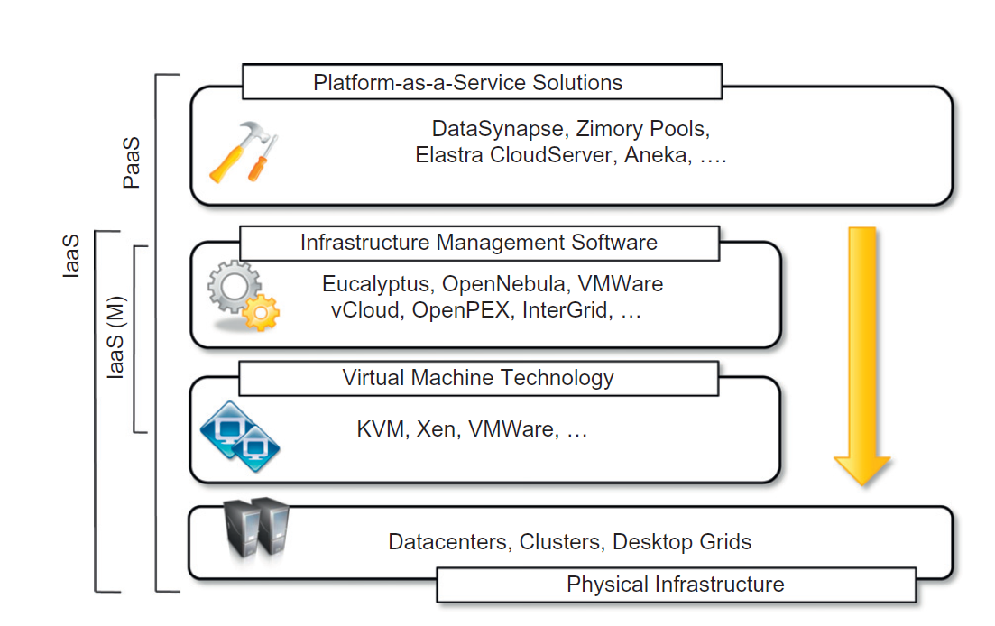

Slide 74
Hybrid Cloud
Keep processing of information within premises
Leverage existing hardware and software
Scale depending on needs and sustain peak load
private cloud that integrates additional services or resources from one or more public clouds
Heterogeneous cloud
Dynamic provisioning to meet demand – cloudbursting
Mostly applies to hardware
OpenNebula: cost based advanced Haizea scheduler uses QoS and budget

Slide 75
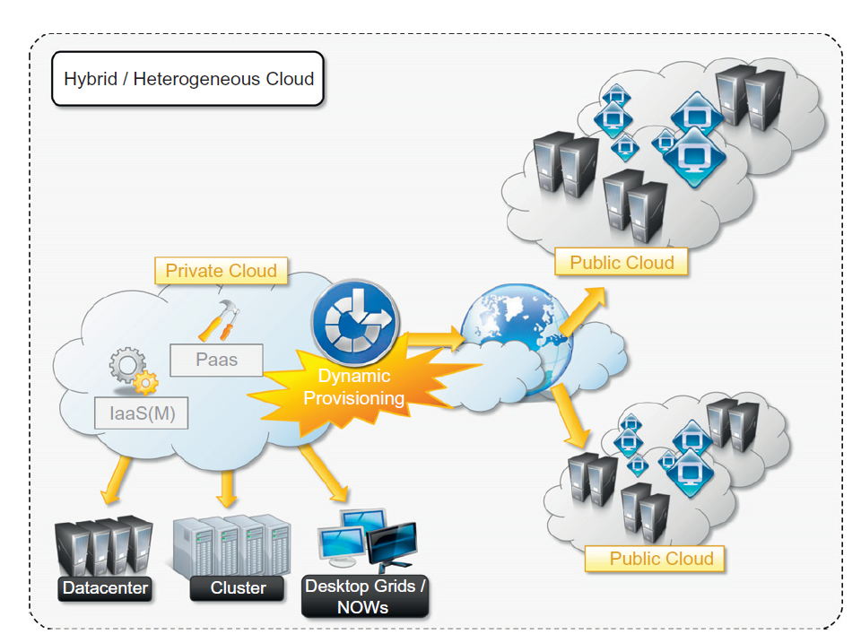

Slide 76
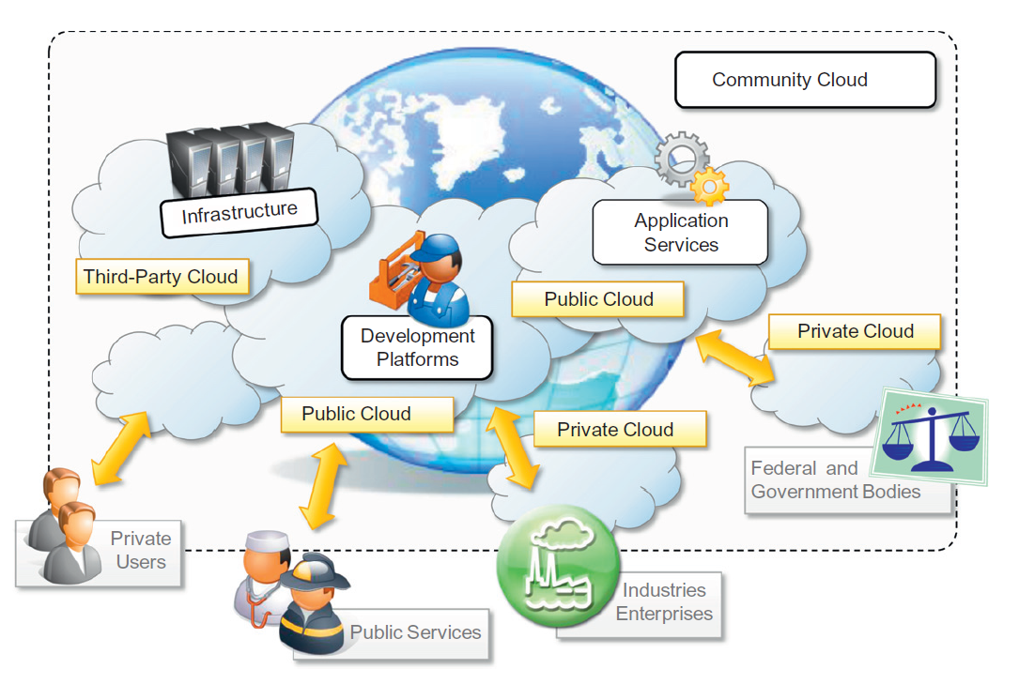

Slide 77
Pricing
Tiered: different types of EC2 instances
Per unit: data transfer, per GB storage
Subscription based: SaaS, for application(s) / service, per month
Combination of above: per GB per month for s3fa

Slide 78
Assignment
Google account
Google drive
Spreadsheet
Note

Slide 79
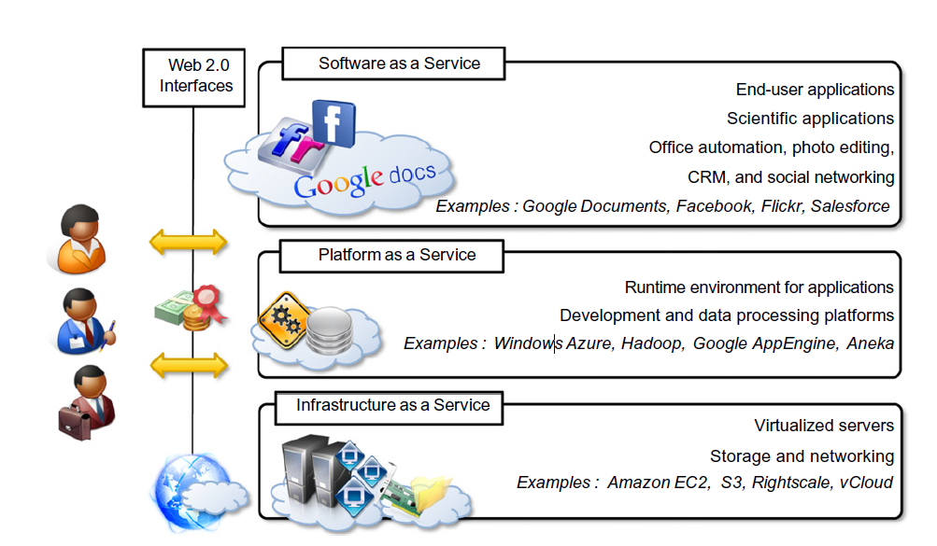
Layers / Reference Model

Slide 80
Cloud Computing Platforms
Sameer Mahajan
https://www.linkedin.com/in/sameersmahajan/

Slide 81
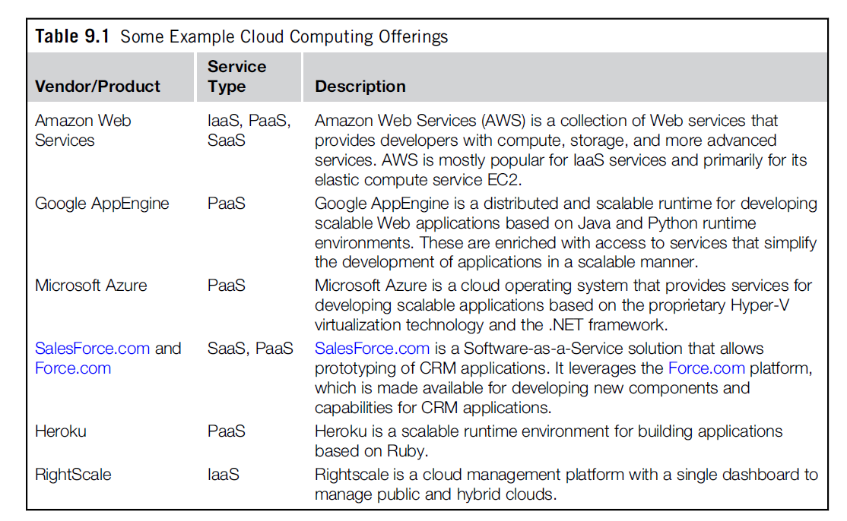

Slide 82
Amazon Web Services (AWS)
SOAP or RESTful web service interface, web based console, CLI, SDK
Raw compute: EC2, raw storage: s3
EC2 VM with image having predefined software stack, instance configured with memory, processors and storage, remote access
Amazon Machine Image (AMI) templates to create a VM, stored in s3 and have unique identifiers, contains Amazon Ramdisk Image (ARI) and Amazon Kernel Image (AKI)
vCPU / virtual cores and ECU =1.0 -1.2 GHz 2007 Opteron or Xeon processor
Volatile spot instances with user defined price thresholds

Slide 83
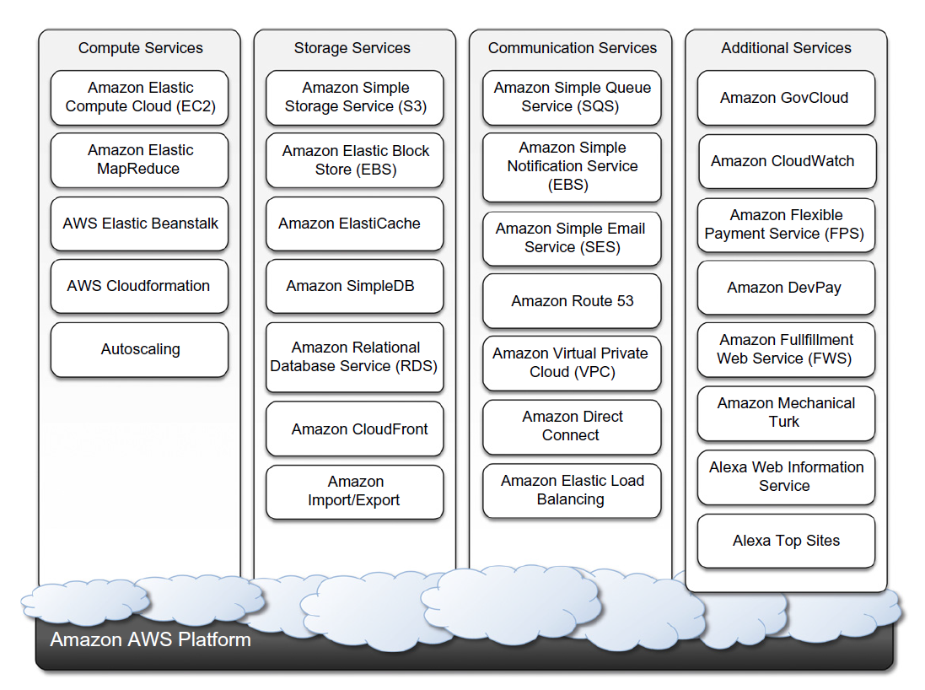

Slide 84
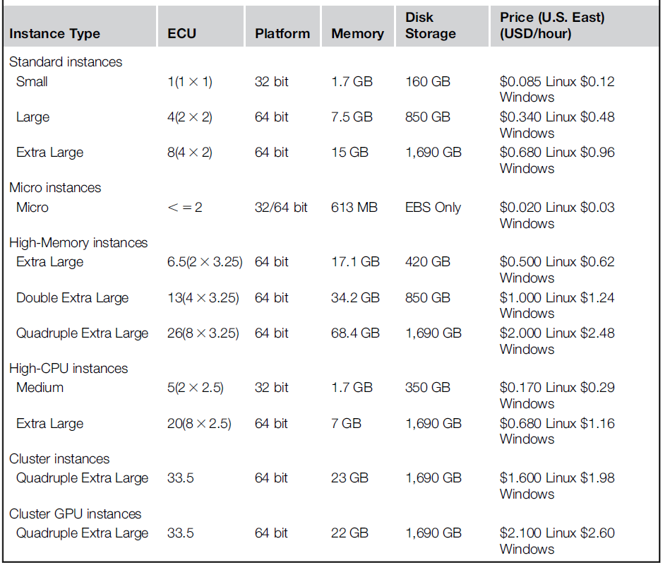

Slide 85
EC2 Environment
Storage: Ephemeral or EBS
Networking: Internal IP (within EC2, client to internet), public IP (remote access over internet), elastic IP (server, failover)
Security: Access control
Domain name ec2-xxx-xxx-xxx-xxx.compute-x.amazonaws.com, xxx-xxx-xxx-xxx represents external IP compute-x gives availability zone
69 availability zones priced differently, 23 regions (Nov 2019)
Key pair, security groups, firewall rules

Slide 86
Advanced Compute Services
CloudFormation: templates, describe resources and services and relations between them required to run an application, integrate EC2 with other services like S3, SimpleDB, SQS, SNS, Route 53, Elastic Beanstalk etc.
Elastic Beanstalk: package and deploy applications, provision instances, Web applications with Java / Tomcat, WAR file, flexible, higher level
Elastic MapReduce: Hadoop, EC2, S3, Support Pig, Hive etc., dynamic sizing, selects appropriate configurations of EC2 instances, basic web applications to quickly run data-intensive applications without writing code

Slide 87
Storage Services: Simple Storage Service (S3)
distributed object store
Buckets: virtual containers to store objects, cannot be further partitioned, top level, no nesting
Objects: stored content
RESTful interface: HTTP Requests (GET, PUT,DELETE,HEAD, and POST)
Renmaing, modifying or relocating not allowed
Eventual consistency
Requests fail occasionally

Slide 88
S3 (contd)
three different URI ways of addressing
Canonical form: http://s3.amazonaws.com/bukect_name/[object_name]
Subdomain form: http://bucket-name/s3.amzonaws.com/[object_name]
Virtual hosting form: http://bucket-name.com/[object_name] needs DNS
S3 is flat data store so unique bucket names across all users
Object ACL: http://s3.amazonaws.com/bukect_name/object_name?acl
Bucket server logging: http://s3.amzonaws.com/bucket_name?logging
Metadata are manipulated as attributes of in the request
Bucket and all its objects belong to a specific region

Slide 89
S3 (further contd)
List content of bucket with GET
Name cannot be longer than 1024 UTF-8 encoded bytes
Names can have ‘/’, way to achieve folder hierarachy
Maximum object size is 5 GB
Access Control Policies (ACP): READ, WRITE, READ_ACP, WRITE_ACP, FULL_CONTROL
Advanced features
Server access logging
Torrent

Slide 90
Elastic Block Store (EBS)
Persistent storage in the form of volumes
Can be mounted at EC2 instance startup
Up to 1 TB storage, block device interface (raw, FS etc.)
Stored in s3, cloning, snapshot
Typically in same AZ, lazily loaded, not shared, multiple volumes
Cost by storage size in S3, #I/O requests and throughput
SSD / HDD, gp3 / gp2 / io2 / st1 / sc1
$0.08/GB-month, 3,000 IOPS free, $0.005/provisioned IOPS-month

Slide 91
ElastiCache
Elastic in memory cache based on cluster of EC2 instances
Mecached compatible protocol through web services
ElastiCache cluster is dynamically (re)sized based on demand
Automatic patch management, failure detection, recovery
Priced according to EC2 pricing model with some differences due to the use of the caching service installed on such instances

Slide 92
Structured Storage Solutions
Preconfigured EC2 AMIs
IBM DB2, Microsoft SQL Server, MySQL, Oracle, PostgreSQL, Sybase, and Vertica
Priced hourly according to the EC2 cost model
EC2 user has to configure, maintain, and manage the DBMS
Relational Data Storage (RDS)
Managed MySQL or Oracle
Advanced features of multi-AZ deployment and read replicas
SimpleDB: lightweight, not fully relational, flexible, fully managed
Aurora

Slide 93
Communication Services
Among applications and services residing within the AWS infrastructure
Virtual Networking
Between compute and storage
Virtual Private Cloud (VPC) and Direct Connect (user network to AWS), Route 53 for naming (dynamic DNS), Identity Access Management (IAM)
Messaging
Simple Queue Service (SQS), Simple Notification Service(SNS):publish-subscribe, Simple Email Service (SES)
Pay as you go

Slide 94
Additional Services
CloudFront: content delivery network (CDN) on distributed storage infra, leverages strategically located edge servers, reduced transfer time, Web service APIs, distribution with origin server can be in AWS or outside, static or streaming content, access rules, cheaper than S3
CloudWatch: monitoring, earlier subscription, now free
Flexible Payment Service (FPS): sell goods and services to other AWS users
Athena
Glue
QuickSight
AWS SDK for Python (Boto3)

Slide 95
Google AppEngine
PaaS for developing and hosting scalable web applications
Java, Python, Golang
Managed or interpreted languages
Sandboxing: Cannot write to server’s FS, execute more than 30 seconds
Java Server Pages (JSP), Python Web Application framework (webapp)

Slide 96
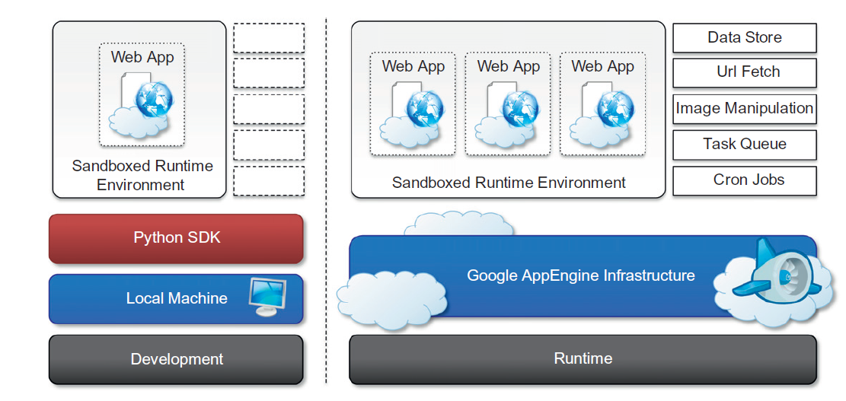

Slide 97
Storage
Static File Servers: CSS, html, javascript static content
DataStore: sem istructured data, object database, BigTable based, entities and properties, entity has immutable key, indexes, transactions, query by specifying either the key or conditions on the values of the properties, pre computed indexes (based on queries) – query execution is independent of data size but influenced only by result set size, entity is updated atomically, multiple updates or multiple entities (in the same entity group) in a transaction, optimistic concurrency control, no exception retrieving an entity

Slide 98
Application Services
UrlFetch: retrieve remote resources, request can specify deadline, async, integrate meshes into web pages, leverage remote web service
MemCache: distributed in memory cache for fast access
Mail and IM: communication, XMPP for IM
Account Management: Google Accounts, user profiles, authentication
Image manipulation: light weight image processing with speed

Slide 99
Compute Services
Real time and synchronous within web request timeframe
Task queues: submit a task for later execution, long computations, up to 10 queues, queue invokes request handler for task execution, queue re executes failed task until it is successful
Cron jobs: to be performed at specific time (e.g. nightly), does not re execute in case of failure, maintenance or notifications

Slide 100
Application Lifecycle
Develop on local development environment, simulates AppEngine runtime by providing mock implementations of DataStore, MemCache, services, hosting web applications, monitoring and tuning
Java SDK: Eclipse with google appengine plugin, servlet, Eclipse web platform, CLI
Python SDK: standalone GoogleAppEngineLauncher tool, integrated webapp, Django, CLI
Create application identifier (.appspot.com), deploy / upload, manage and monitor by administrative console, versioning, billing
Free service with limited quotas reset every 24 hours
billable, fixed, and per-minute quotas; 403 error once quota reached

Slide 101
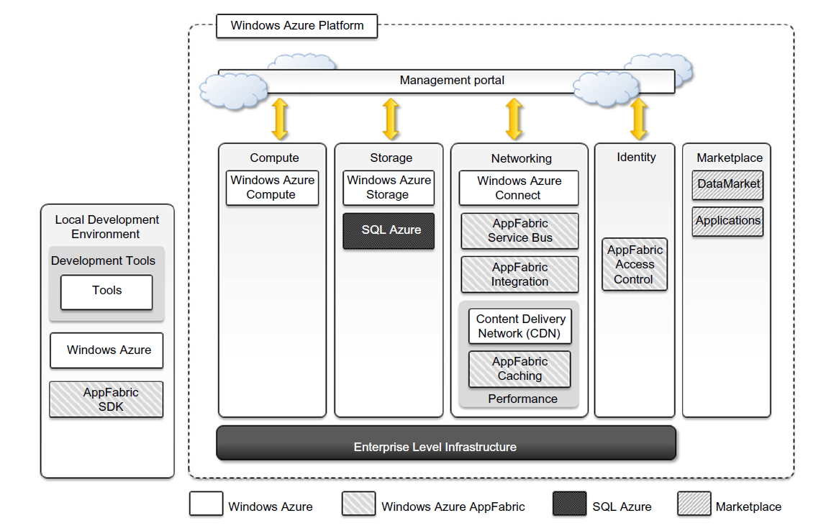

Slide 102
Compute Services
Web role: web applications, hosted on IIS, auto scaled, native support since .Net 3.5, ASP.NET and WCF applications, PHP runtime via FastCGI, non IIS technologies like JSP on Tomcat can also be hosted
Worker role: general compute, do not communicate with the external world through HTTP, background processes, continuously running service, any technology that runs on a Windows Server stack
Virtual Machine role: fully control the computing stack, Hyper-V based, Virtual Hard Disk (VHD) with custom stack

Slide 103
Storage Services
Durable, not local, can be accessed by multiple clients at the same time and from everywhere
Blobs: binary large objects, metadata, snapshots, CDN
Block blobs: sequential access, media streaming, 4 MB block, 200 GB blob
Page blobs: random access, 1 TB
Azure drive: A page blob mounted as part of an NTFS tree
Tables: semi structured storage, entities as rows, properties as columns, key / index, insert, update, delete, select a subset of rows, no schema, partial result sets, partitions for load balancing across servers, 100 TB, 255 properties, 1 MB row, 1 kb keys
Queues: message exchange across applications, FIFO, read message -> invisible, processed message -> deleted, peeking
Triple Replication

Slide 104
Core Infrastructure
AppFabric: middleware for developing, deploying, and managing applications, language agnostic interfaces
Access Control: rules to access resources, integrates with authentication providers like Active Directory (AD), Windows Live, Google, single coherent identity management framework
Service bus: messaging and connectivity infra, services as URLs, pub-sub, full duplex, peer to peer, multicast, async, connections per month pricing
Azure cache: elastic distributed in memory cache, .Net managed objects, any format, easily integrated with applications, priced by allocated size

Slide 105
Other Services
Virtual Network: Connect – IP based, VM roles and Traffic Manager – load balancing
CDN: static or streaming, 24 locations distributed across the world
SQL Azure: RDBMS, accessible from cloud or any other location having access to cloud, Tabular Data Stream (TDS) protocol, ODBC or ADO.NET, billed by space and edition, Web edition (1 or 5 GB), Business edition (10-50 GB)
Windows Azure Platform Appliance: windows, SQL, configuration of network, storage, hardware

Slide 106
Assignment
Setting up big data fabric in AWS https://www.youtube.com/watch?v=4VJvjnkDDfs

Slide 107
Cloud Applications
Sameer Mahajan
https://www.linkedin.com/in/sameersmahajan/

Slide 108
Cloud Applications
Migrate to the cloud
Bootstrap (SDK, APIs, programming environments) for the cloud
Develop for the cloud
Cloud first / Cloud born
Rich Internet Applications (RIA) with and without browser
Abstraction based at programming language, environment (e.g. browser) level

Slide 109
Evolution of Abstraction
Programming Language: assembly -> macro assembler -> cobol -> fortran -> C -> Java -> python, Go -> Stats / no code ML / AutoML
Browser tightly integrated with OS and hardware, browser plugins instead of applications, simple installation, small footprints
Adobe Integrated Runtime (AIR) : Java, Flash, Windows, Linux; Microsoft Silverlight
Advantages: ease of development and maintainability
Disadvantages
system overhead (speed, final machine code), not tight, concise
security, toolbars have full access to your desktop

Slide 110
Clouds Use Cases
Times: converting 11 million articles into .pdf for online archive. Estimated 100 servers with 4 TB storage taking months. AWS 100 EC2, 4 TB s3 in a day with cost of only $240
Washington Post: 200 EC2 server instances to process 17,481 pages of non-searchable PDF images into a searchable online library. 9 hours, a minute per page. $144.62
Above two are processing and throwaway clouds, use only once
Storage Clouds: s3, dropbox, google drive, backup, smart switch
Traveling clouds: USB drive with 5 preinstalled windows servers, mounted locally in AWS for a conference demo
Occasional use clouds: interopnet VM images / virtual appliance, spun up once for Vegas and once for New York events every year
DR: storage side synced up at DR site not incurring compute side cost but still warm to able to be brought up immediately in case of disaster without any delay

Slide 111
Scientific Applications
Researchers and academics
Availability of compute and sustainable price of storage compared to complete in-house deployment, minimal changes
High performance (HPC), high throughput (HTC), data intensive
IaaS, PaaS, MapReduce – data intensive
Healthcare – diagnostics, health monitoring, ECG analysis

Slide 112
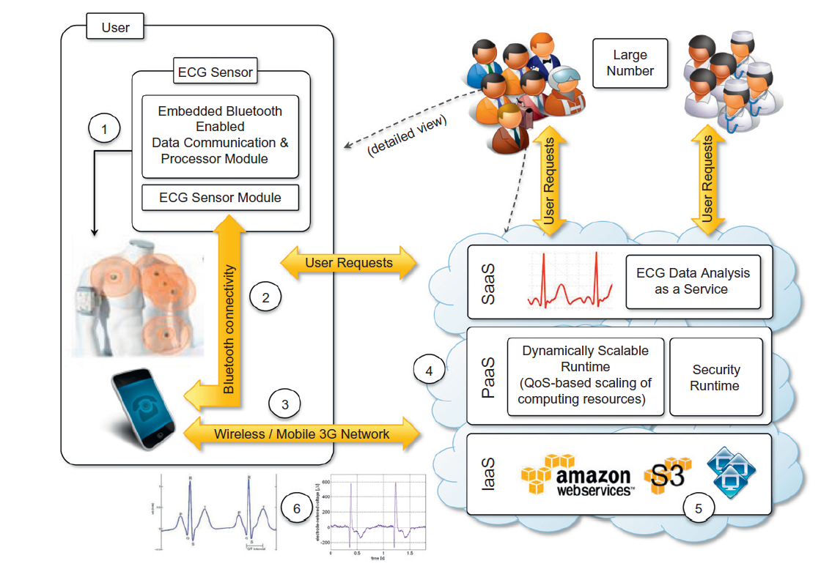

Slide 113
Case Study – Data science based technology platform
About the client
Our client is a technology healthcare startup developing a platform to diagnose mental & physical health of patients based on their voice samples. They have partnered with a premier research lab and licensed speech features pertaining to some health conditions such as depression.
Solution & outcome
Scalable platform to power mobile apps and partner apps adhering to region-specific legal constraints
Challenges
Create a platform that can score a participant on clinical (depression, Alzheimer’s etc.) or wellness (nasality, stress, sleepiness etc.) based on few seconds of voice.
Develop mobile apps for
Clinical studies with hospitals or pharma partners for discovery of new vocal biomarkers
Organizations to monitor wellness of their employees or end-customers
Power partner apps through APIs and SDKs
Accelerate discovery of models for new conditions with help of internal tools
‘Discovery’ of models for new health conditions reduced from few months to few weeks leveraging rapid experimentation and self-service tools and processes

Slide 114
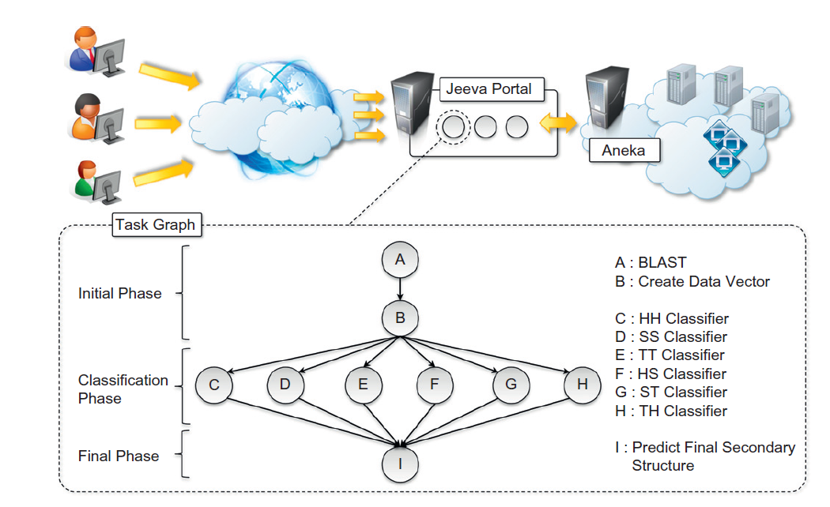
Biology: protein structure prediction

Slide 115
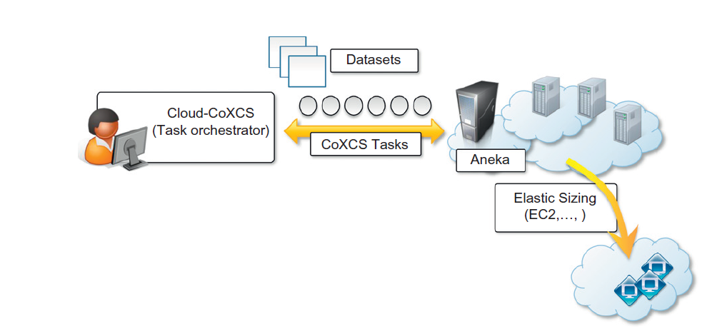
Biology: gene expression data analysis for cancer diagnosis

Slide 116
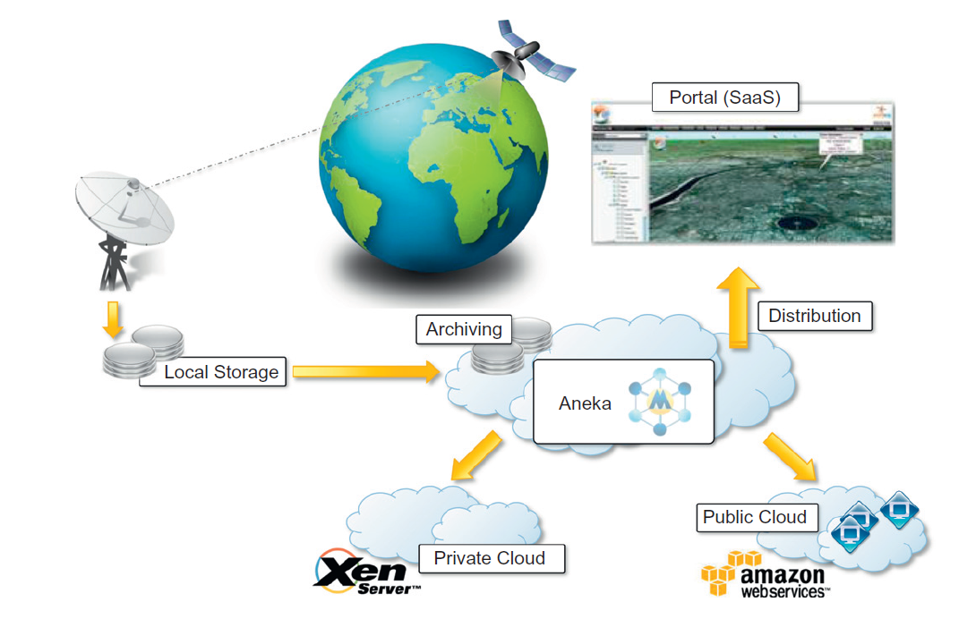
Geoscience: satellite image processing

Slide 117
Business and consumer applications
Transform capital costs into operational costs
Data and services can be accessed from anywhere, anytime, anyone
Elastic nature with auto scaling – quickly release products and services
Customer Relationship Management (CRM): salesforce.com – 100k customers, Microsoft dynamics CRM – 99.9% SLA, NetSuite
Enterprise Resource Planning (ERP): finance, accounting, HR, manufacturing, supply chain, project management, NetSuite

Slide 118
More applications
Productivity
Dropbox: synchronize any file across any platform, any device, through browser or client
Google docs
Cloud web desktop: EyeOS, Xcerion XML Internet OS/3 (XIOS/3)
Social networking: facebook, twitter, Instagram, linkedin
Media applications: Netflix, youtube
Multiplayer online gaming

Slide 119
Provider Support
AWS: supports all languages, environments
GCP: web and google centric
Azure: .Net and windows centric
Blurring lines between mobile and desktop,1000+ contacts on mobile phone backed up in cloud

Slide 120
Cloud Security
Sameer Mahajan
https://www.linkedin.com/in/sameersmahajan/

Slide 121
The Spectrum
Two categories
Assets (hardware, software, network infrastructure) – traditionally
Data – more important today
At rest
In motion
User Authentication: only authorized users can access resources
Filtering: only authorized data flows into or out of network, unauthorized data should be unusable
Firewall: rule based (devices, appliances)
Deep packet and pattern inspection: signatures
Monitoring: preventing any breach

Slide 122
Authentication
Logically centralized but physically distributed authentication directory
HQ Master – cloud / sites slaves
Read only copies at sites
Identity federation, Single Sign On – single authentication to identify and authorize across multiple systems
Network Access Control (NAC) – endpoints are secure, especially mobile
Agent based, communicates status and configuration to the central server, receives and performs any necessary updates to keep the endpoint latest and secure, polling from server based
No access at all if not authenticated in case of NAC / cloud
Microsoft’s version is called NAP

Slide 123
Cloud Filtering
Firewall operates at low network level, ports, protocols, IP addresses, filter incoming traffic
IDS, Intrusion Prevention System (IPS), Unified Threat Management (UTM) look for patterns, filter incoming as well as outgoing traffic
Web filters operate at higher level and look at data stream content
Data leakage prevention systems filter outgoing traffic
IDS is like burglar alarm, IPS is real time
Email filtering, application blocking
Takes significant computing power
Only tap at source to redirect and process elsewhere, process at source leveraging auto scale and reduce traffic

Slide 124
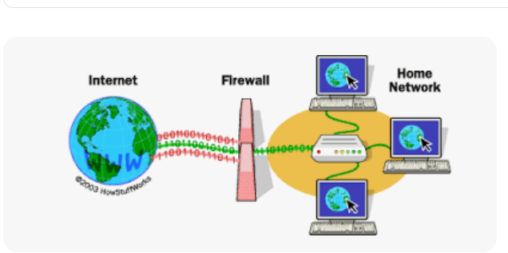
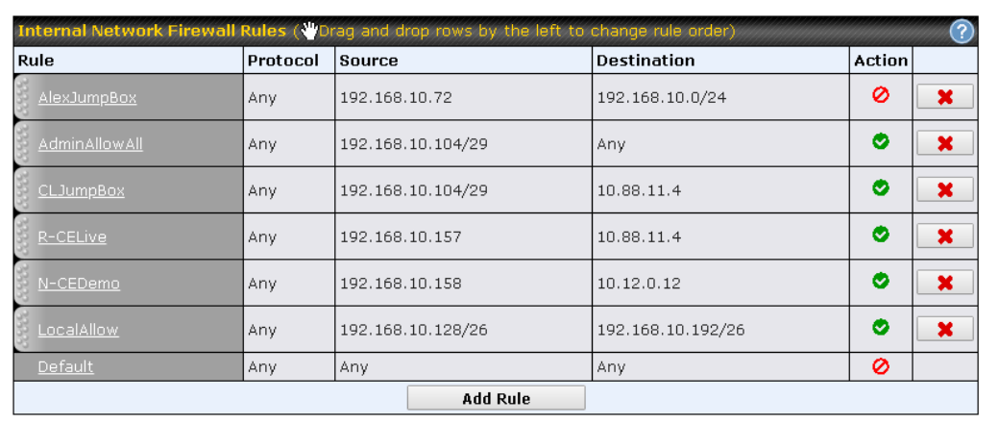

Slide 125
Firewalls
Cisco
SonicWall NSA 16 core caveum
Astaro VM
Autoscale firewall VMs from load balancers
Autoscale servers and firewalls in front of them
VM in cloud can also be monitored for its performance using Simple Network Monitorning Protocol (SNMP) or Windows Management Instrumentation (WMI)
Virtual Private Network (VPN) to connect to protected virtual networks

Slide 126
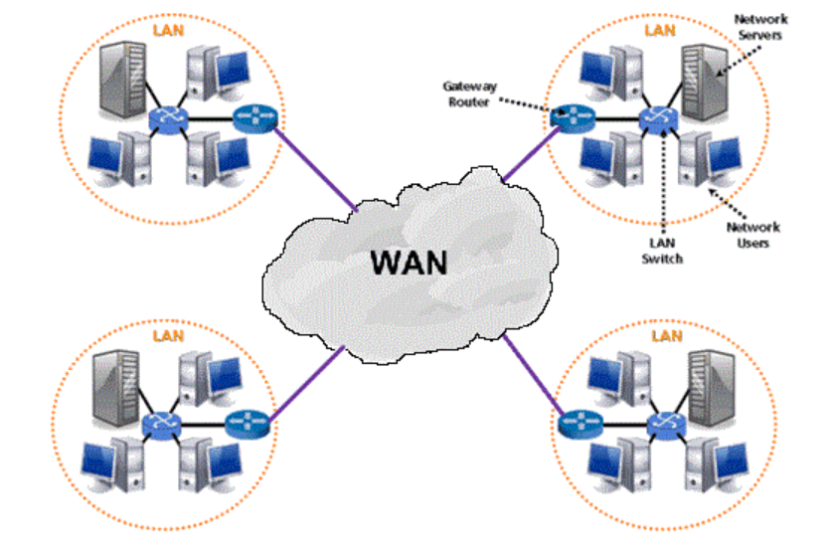

Slide 127


Cloud Security Alliance
Cloudsecurityalliance.org
Security guidance
Security architectures
Roles, responsibilities, models

Slide 128

Broker
Cloud
Storage

Slide 129
Encryption Using Normal Passwords – data at rest
I, Julie Andrews,
residing at 42 ...
How it works:
• At encryption
» Software asks for password » You can pick any password
• At Decryption
» Software asks for password » Must provide same password
ORIGINAL
Encryption
Decryption
PASSWORD
y</PLVDg/kzExgWO</xgODEDze/?p/å"/!!!
ENCRYPTED

Slide 130


Encryption Using 2 Passwords – data in motion
I, Julie Andrews,
residing at 42 ...
PASSWORD1
ORIGINAL
PASSWORD2
y</PLVDg/kzExgWO</xgODEDze/?p/å"/!!!
ENCRYPTED

Slide 131
Works in Reverse Too
I, Julie Andrews,
residing at 42 ...
ORIGINAL
PASSWORD2
PASSWORD1
y</PLVDg/kzExgWO</xgODEDze/?p/å"/!!!
ENCRYPTED

Slide 132
Authentication
ORIGINAL
Authentication Usage: • Encrypt a random text with private key
» e.g. Today's date
• Anyone can confirm » By decrypting using public key
• None else can do this
I, Julie Andrews,
residing at 42 ...
Initial setup for authentication:
• Public key + Private key = Keypair
• Everyone creates keypairs
• Publicly publish all public keys
• Private keys kept hidden
PRIVATE KEY
PUBLIC KEY
y</PLVDg/kzExgWO</xgODEDze/?p/å"/!!!
ENCRYPTED

Slide 133
Advantages
Bad traffic can be intercepted and stopped before it ever reaches the enterprise network to avoid any liability, threats
Mobile devices are vulnerable to malware, not many antimalware for mobile and have overhead, cleaner data for lighter clients
Filter at source, spam email filters, easy to catch in transit malware
Security systems as building blocks, can be changed easily to adapt
Spin up another IDS when malware detected requiring more resources
Eliminates single point of failure
Abilities on demand – download karate like Neo in The Matrix

Slide 134
Limits
Speed or bandwidth related
Willingness of management to trust security in cloud
Regulators’ reluctance, consider abstraction layers as obfuscation
Existence of on prem firewalls preventing cloud based firewalls adoption
Customization of authentication systems (granularity of identifying groups of users, user defined fields)
Regulators and cloud providers working together towards cloud security

Slide 135
Future
Improving compute and bandwidth is helping
Fuzziness of network boundary due to mobile devices, telecommuting or work from home (WFH) employees
Use case: Card swipe for physical entry and VPN login for the same user from another country at the same time
Single security infrastructure for various OS, platforms, from anywhere
More security
Ease of management with single pane

Slide 136
Cloud Challenges
Sameer Mahajan
https://www.linkedin.com/in/sameersmahajan/

Slide 137
Stability
How many internet feeds you have? Do they come into your data centers through different cable paths? Consider road digging and fiber cut!
Kind of backup power. Kind of fuel for generators and how much they have. Are they tested and serviced regularly.
Where is DNS hosted? Its availability on site as well as in Internet.
NAT, network demarcation point, out of band network
Remote access to consoles
Change management system to track power down
Physical security like access cards etc.
Administrators, on site spare parts

Slide 138
Partner Quality
Provider’s relationship with its partners
(Not so normal) circumstances like slammer
How fast provider can work with partners setting up ACLs to block attacks
Inadvertent changes in internet routing e.g. BGP peering table
.edu to .com within city of Honolulu went all the way through Chicago!

Slide 139
Longevity
How long your provider can support you
Cloud provider shuts down: PictureBug closed in October 2007
Cloud failure can bring your business to standstill
Imagine google (along with its gmail and google accounts) close down!
Can I get my data, apps, images back?
Advance notice, contracts, enforcements
Look out by provider’s financial reports
Cash rich like Amazon or backed by experience and trustworthy
Provider’s staffing, automation, available templates, documentation

Slide 140
Service Level Agreement (SLA)
Few risks and many benefits as possible
Troubleshooting capabilities
Should / should not be negotiable
Cover everything that can possibly go wrong
Cover damages in case of business impact
As quantitative and objective as possible
Exercise regularly and not only when things go wrong
Keep data ownership with you
Have plan B ready
Ensure physical jurisdiction, tech and legal hand-in-hand

Slide 141
Reaching agreement
Communication between VMs on the same host, tapping traffic for analysis
Promiscuous mode, peeking into vSwitch traffic
Quality of Service: understandable voice over VoIP, not much interruptions due to buffering while watching a video, performance expectations, user experience, profiling, measurable metrics
Don’t rely completely on the provider for security but have your own layer
Control over failover and load balancing in cloud
Regulatory : putting in cloud considered as publishing giving up patenting rights, auditing

Slide 142
Business factors
Who has control over data
Training and personnel cost, hidden costs
Regulations, where is my data (load balancing)
Abstraction layers make it difficult to enforce policy (proxied internet access)
Does cloud support your applications or is migration required?
Bandwidth support (cost, apps, firewalls) to and from external cloud
Speedtest.net, iperf, ixia chariot application
Load balancers: traditional, dedicated servers for peek load, vMotion
On prem – cloud, salesforce - SugarCRM combos
Websites, liability, SMBs partnering with VARs
Collaboration through cloud, shared s3 storage without compromising privacy
Identity federation (LDAP, eDirectory, Active Directory)

Slide 143
Planning and Future for Cloud
Sameer Mahajan
https://www.linkedin.com/in/sameersmahajan/

Slide 144
Licensing
Per CPU, VM has single CPU but physical machine may have 8
Multiple copies on VMs on the same physical machine
License dongles
License servers
Some versions may not support virtualization
Overhead of abstraction, tuning for optimal throughput

Slide 145
First Steps
Short term and long term, revisit at every technology refresh cycle
Keep asking: “does it make sense for my organization?”
Might have to adopt some cloud due to partners / vendors etc.
Test drive / trial
If no 24/7 data centers in house, you can shutdown at nights, weekends
Collocation as first step towards moving to cloud completely
Remote access, IP KVM, console access, VMWare, Hyper-V support

Slide 146
Further steps
Peaks and Valleys – auto scale, blade servers can run full load all the time
Energy efficiency: power supplies are most efficient with in the middle of their load range, green devices, green incentives and initiatives
Starter kit, migration utilities, eat learning curve / training / getting used to
Virtualization as a stepping stone towards cloud, free trial software, old / retired servers
Planning for success, cloud just an aid, well understood application
Websites for contests, globally accessed CRM

Slide 147
Advancements
Energy efficiency: single datacenter consumes as much energy as 25000 households, doubles every 5 years, 42% of Amazon’s budget
The Green Grid: increase energy efficiency, reduce carbon footprint, $23 (2010) -> $16 (2020) billion, 28% less emission
Green scheduling
Market oriented, broker, bid / negotiate
EC2 spot instances
SpotCloud
AppSpot

Slide 148


Slide 149
Advancements (contd)
Federated clouds
ad hoc
agreement between cloud providers to use each other’s services
Proprietary interfaces
InterCloud
Standards
Interoperability
Third party cloud services: MetaCDN (over storage clouds), SpotCloud

Slide 150
Future
Standardization
BOINC, Blockchain, leverage distributed available compute
Specialized clouds
Google docs, Microsoft office live, quora
Mobile cloud: heavy lifting by back end cloud, maps
Multi programming -> multiple VMs
Cloud extensions: AutoCAD -> Building Information Modeling (BIM)
Cloud Descriptor Language (CDL): capturing resource requirements
Cost, control, bottom line – profit
Full cycle; mainframe – dumb terminals, cloud – thin clients
Ubiquitous computing, abstraction -> focus on business rather than tools

Slide 151
Assignment
Install xampp from https://www.apachefriends.org/
Open XAMPP Control Panel
Start Apache
Create a folder in c:\xampp\htdocs, say demo
In demo folder write your html embedded with php and suffix it .php
Open localhost/demo from your browser
Navigate to your file
Try http://localhost/demo/webfeed.php?q=Google https://github.com/sameermahajan/CloudComputing/blob/main/webfeed.php for webfeed
RSS Feed Reader chrome plugin
Complete video: https://youtu.be/0co2rns_9Bs

Slide 152
Thank You
&
Good Luck

